Slide 1

Executive Business Presentation
Ram Sundar

Slide 2
Agenda
Business problem and operational risks
System architecture and data flow
Key insights from SQL and EDA
Model performance in business terms
Financial impact and ROI estimation
Deployment and scaling strategy
Risk management and compliance plan

Slide 3
Business problem and operational risks
The Problem
Healthcare organizations face two interconnected operational challenges:
Patient Risk Triage: Hospitals cannot efficiently prioritize patients at check-in. Without automated risk stratification, clinical staff rely on subjective assessment, leading to delayed care for high-risk patients and misallocated resources across departments.
Insurance Claim Outcomes: Claims processing is reactive, not predictive. Rejected or pending claims (claim statuses: Paid / Pending / Rejected) create revenue leakage, delayed cash flow, and administrative overhead. Billing teams discover rejections only after submission.
Operational Risks Identified
Department-level risk concentration: Certain departments (Cardiology, ICU, ER) handle disproportionately high volumes of "High" risk visits, requiring targeted staffing
Insurance provider variability: The top 5 providers show significantly different rejection rates, indicating that claim preparation must be provider-aware
Payment delays: Average payment days vary by insurance provider, impacting cash flow predictability
Revenue realization gaps: Revenue realization ratios (approved/billed) differ significantly by department; some departments show high billing with zero approved amounts
Data integrity issues: Orphaned visits (no billing record), missing payment days, and invalid length-of-stay values detected in source systems

Slide 4
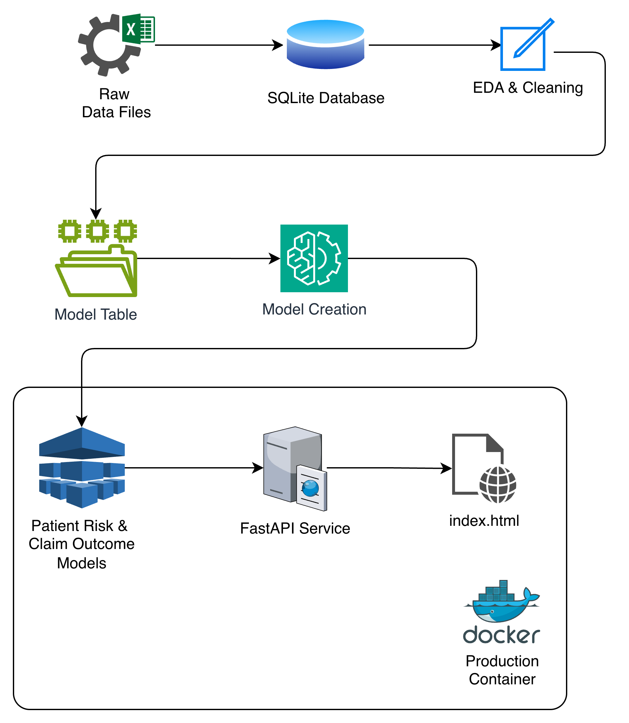
System architecture and data flow
Raw CSV data ingested into SQLite database with indexed foreign keys
13 engineered features added in Phase 2: visit_frequency, avg_length_of_stay, days_since_registration, total_billed, avg_payment_days, provider_rejection_rate, doctor_rejection_rate, visit_month, visit_day_of_week, visit_quarter, is_weekend, days_between_reg_and_visit, billing_delay_days
Missing values imputed with hierarchical median strategy (patient → department → global)
Time-based 80/20 train/test split (no shuffling — prevents data leakage)
Models serialized as .pkl pipelines with corresponding feature_schema.json for validation
Every API prediction logged with UUID, model version, timestamp, SHA-256 feature hash, label, and confidence score

Slide 5
Key insights from SQL and EDA (1/2)
Analysis | Key Finding
Department visit volume | Top departments by volume identified; enables capacity planning
Length of stay | Significant variation across departments — ICU and specialty wards have highest average stay
High-risk concentration | Certain departments carry a disproportionate share of High-risk visits
Doctor workload | Top 10 doctors handling the most High-risk visits identified — workforce balancing opportunity
City-level utilization | Average visits per patient varies by city — geographic resource allocation insight
Insurance billing | Total billed amounts differ significantly by provider
Claim rejection rates | Rejection rates vary across insurance providers — some providers are harder to collect from
Payment delays | Average payment days differ by insurer — cash flow planning signal
Revenue realization | Department-level approved/billed ratios reveal where money is being left on the table
High-bill zero-approval | Flagged visits with billed amount > $1,000 but $0 approved — potential billing errors

Slide 6
Key insights from SQL and EDA (2/2)
Finding | Detail
Target distributions | risk_score: ~50% Low / ~30% Medium / ~20% High; claim_status: ~65% Paid / ~15% Pending / ~20% Rejected
Class imbalance | Both targets are imbalanced; addressed via SMOTE (training only) and PyCaret's fix_imbalance
Missing values | approved_amount, payment_days, length_of_stay_hours had missing values — imputed with cascading median strategy
Outliers | Detected in billed_amount, payment_days, length_of_stay_hours via IQR method
Feature correlations | All correlations with risk_score are weak (max |r| ≈ 0.025) — expected for categorical target; tree models handle this
Billing date anomaly | billing_date is largely frozen (same date) — billing_delay_days flagged as unreliable and excluded

Slide 7
Model performance in business terms Model 1
Model 1: Patient Risk Classification
Purpose: Predict visit risk (Low / Medium / High) at the moment of patient check-in
Attribute | Detail
Algorithm | XGBoost (gbtree) via PyCaret pipeline
Features | chronic_flag, gender, visit_frequency (3 features — all available at check-in)
Best Macro F1 | 0.3246 (best among all model variants tested)
Why this model? | Highest Macro F1 ensures High and Medium risk patients are identified, not just the majority Low class
Training approach | Time-based split, SMOTE for class balancing, PyCaret-optimized hyperparameters
Key hyperparameters | learning_rate=0.15, max_depth=8, n_estimators=10, subsample=0.5, reg_alpha=2
Models benchmarked: Logistic Regression (baseline), XGBoost (default), Random Forest, XGBoost (GridSearchCV tuned), all with and without SMOTE, demographic-only experiments — PyCaret XGBoost selected as production model.
Business translation:
Enables automated triage prioritization — High-risk patients flagged immediately at check-in
Lean 3-feature design means zero additional data collection needed at point of care
SHAP explainability allows clinical staff to understand why a patient is flagged

Slide 8
Model performance in business terms Model 2
Model 2: Claim Outcome Classification
Purpose: Predict claim status (Paid / Pending / Rejected) before submission
Attribute | Detail
Algorithm | PyCaret auto-selected best classifier (tuned on MCC)
Features | 12 inputs: age, gender, city, insurance_provider, chronic_flag, department, visit_type, length_of_stay_hours, billed_amount, payment_days, visit_frequency, lag_time
Optimization metric | Matthews Correlation Coefficient (MCC) — penalizes majority-class bias
Training approach | Time-based split, SMOTE for Pending/Rejected oversampling, PyCaret feature selection (top 80%), multicollinearity removal
Business translation:
Pre-submission claim screening — flag likely Rejected claims for review before filing
Identify which provider/department/amount combinations trigger rejections
Reduce rejection-related rework and appeals overhead

Slide 9
Financial impact and ROI estimation
Revenue Leakage Quantified from the dataset (25,000 billing records):
Rejected claims (~20% of claims) represent direct revenue loss
Pending claims (~15%) create cash flow delays and administrative overhead
High-bill-zero-approval visits flagged as potential billing errors
Impact Area | Mechanism | Estimated Benefit
Claim rejection reduction | Pre-screen claims before submission; correct documentation, coding, or submission timing for likely-rejected claims | Even a 10-20% reduction in rejections directly recovers revenue
Faster payment cycles | Predict Pending claims → proactively follow up with insurers | Reduced days-sales-outstanding (DSO); improved cash flow
Triage efficiency | Auto-classify risk at check-in → prioritize High-risk patients | Reduced adverse events, shorter ED wait times, better resource utilization
Staff productivity | Automated risk scoring replaces manual chart review | Nurse/admin time redirected to patient care
Compliance cost avoidance | Audit trail, SHAP explainability, validated inputs | Reduces regulatory risk and audit preparation effort
Cost of Implementation
Infrastructure: Single Docker container, 1 worker process — minimal compute cost — auto-scale as required by visit patterns of patients
Integration: REST API with standard JSON — integrates with any EMR/billing system
Maintenance: Periodic retraining when drift detected (monthly/quarterly cadence)

Slide 10
Deployment and scaling strategy
Current Deployment
Component | Detail
Framework | FastAPI + Uvicorn
Containerization | Docker (Python 3.11-slim, libgomp for XGBoost)
Endpoints | 2 prediction endpoints, 3 health checks, 1 metadata endpoint, 1 web UI
Input validation | Schema-based validation (validate.py) — catches missing fields, range violations, unseen categories; returns all errors at once
Logging | Every prediction logged with UUID, model version, UTC timestamp, SHA-256 feature hash, prediction label, confidence score
Privacy | No raw patient data in logs — only SHA-256 hashes; patient IDs are never accepted as API inputs
UI | Built-in HTML/Bootstrap testing interface with dynamic form (loads valid categories from /metadata/claim-outcome)
Scaling Strategy
Phase | Approach
Current (v1.0) | Single container, 1 worker — keeps RAM predictable (PyCaret models are large)
Horizontal scale | Add container replicas behind a load balancer (not more workers per container)
Production readiness | Health endpoints (/health, /health/patient-risk, /health/claim-outcome) enable orchestrator liveness/readiness probes
Model updates | Swap .pkl file → update version string in Api.py → restart container (zero-code-change deployment)
Schema evolution | feature_schema.json versioned alongside models; validation layer auto-enforces

Slide 11
Risk management and compliance plan (1/3)
Model Risk Management
Risk | Mitigation
Data drift | Evidently AI drift detection on all model features + target distribution (DataDriftPreset + TargetDriftPreset); HTML drift reports generated
Concept drift | Time-based train/test split validates on future-like data; retraining triggers defined
Class imbalance shift | SMOTE applied at training only; production prediction distribution monitored via audit log
Feature schema violations | Real-time validation layer rejects invalid inputs with HTTP 422; all errors surfaced at once
Model staleness | Defined retraining triggers: >30% features drifting, target distribution shift, F1 drop >10%, schema mismatch rate >1% in 24h
Retraining Protocol
Documented checklist: collect new labeled data → re-run feature engineering → retrain → evaluate against baseline → update schema → increment version → swap pkl → restart → smoke test → archive old model

Slide 12
Risk management and compliance plan (2/3)
Compliance & Governance
Area | Implementation
Audit trail | Every prediction logged: UUID, model+version, timestamp, SHA-256 hash, label, confidence
Data minimization | No PII in logs; SHA-256 hashes enable traceability without storing patient data
Log retention | Recommended: 0–90 days hot, 91–365 days cold, >365 days delete/anonymize
Model cards | Full documentation for both models: training data, evaluation metrics, limitations, ethical considerations
Explainability | SHAP waterfall plots for individual predictions; feature importance rankings documented
Fairness monitoring | Gender bias check (risk model uses gender as input), geographic bias check (city in claim model), age-bracket analysis recommended
Prohibited uses | Models must NOT be sole basis for treatment decisions, automatic claim rejection without human review, or denial of care/coverage
Intended uses | Clinical triage support, claims workflow automation, operational resource planning

Slide 13
Risk management and compliance plan (3/3)
Known Limitations
Limitation | Impact
Risk model uses only 3 features | Coarse risk proxy; does not capture diagnosis severity or comorbidity count
Binary chronic_flag | Patients with 1 vs. 3 chronic conditions treated identically
payment_days may not be available at prediction time | Requires imputation strategy at inference
Negative lag_time in training data | Data quality issue; schema enforcement planned for v1.1
25,000 rows is modest for healthcare AI | Minority classes (High-risk: ~5K, Rejected: ~3.8K) may overfit
PyCaret auto-selection non-deterministic | Model type pinning recommended for v2.0
No real-time retraining or online learning | Static model files; requires explicit retrain-redeploy cycle
Verified Governance Artifacts
All artifacts confirmed present: both .pkl model files, both feature schema JSONs, validate.py, Api.py, predictions.log, both HTML drift reports.

